Slide 1

DCSC Training Week
Development
Operations
Jenkins – A Continuous Integration Tool
Presented By
Rupamdeep Kaur

Slide 2

Agenda
Development
Operations
What is Continuous Integration
Introduction to Jenkins
Installing Jenkins
Configure Jenkins
Building Jobs with Jenkins
Monitoring Jobs in Jenkins
Job Configuration in detail
Parameterized Builds
Accessing Jobs using source control
Schedule Jobs
Setup a Deploy Job
Connect Upstream-Downstream Jobs
Jenkins Pipelines

Slide 3
Development
Operations
Continuous Integration
What is Continuous Integration ?
Continuous integration (CI) is a software engineering practice in which isolated changes are immediately tested and reported on when they are added to a larger code base. The goal of CI is to provide rapid feedback so that if a defect is introduced into the code base, it can be identified and corrected as soon as possible. Continuous integration software tools can be used to automate the testing and build a document trail.

Slide 4
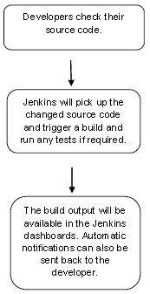
Development
Operations
Jenkins
What is Jenkins?
Jenkins is a continuous integration tool that is used to streamline the task or performing application builds and deploys. Jenkins is open source and is java based. It integrates well with traditional Java build tools, such as Apache Ant and Apache Maven. The following flowchart demonstrates a very simple workflow of how Jenkins works.

Slide 5
Development
Operations
Jenkins
History of Jenkins :
Jenkins was originally developed as the Hudson project. The primary developer of Hudson was Kohsuke Kawaguchi, who worked for Sun Microsystems at the time. It was first released in java.net in Feb. 2005.
Around 2007 Hudson became known as a better alternative to CruiseControl and other open-source build-servers. Later Oracle overtook Sun Microsystems and claimed Hudson to be under its trademark. As a result, a proposal was made to change the project name from Hudson to Jenkins. It was decided by the majority of the development community, including Kawaguchi, to continue the project under the name Jenkins in early 2011. Oracle maintained that Hudson was continuing development and that Jenkins was a fork; the Jenkins developers considered Hudson to be the fork.
Released under the MIT License, Jenkins is free software.

Slide 6
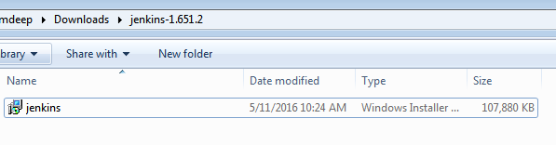
Development
Operations
Jenkins Installation
Navigate to website : https://jenkins.io/ and download the .war file for Windows
Extract the downloaded zip package and run the installer.
Earlier, the official website for Jenkins was located at URL https://jenkins-ci.org from where one had to download the ‘Jenkins.war’ file, and extract and run it to install Jenkins.
Now you can download the package as shown above.

Slide 7
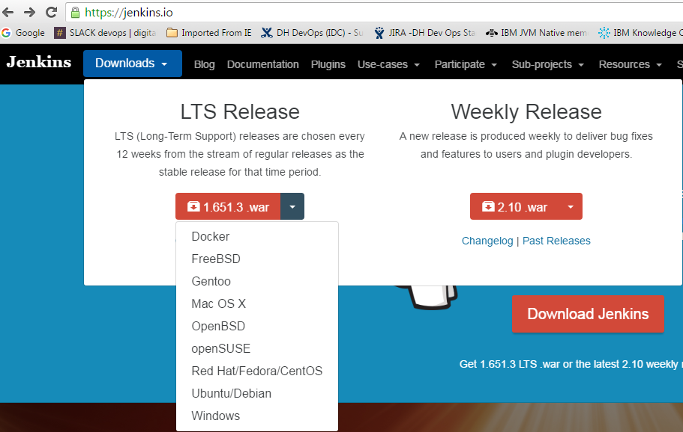
Development
Operations
Jenkins Installation
Similarly to install Jenkins on other Operating Systems, you can navigate to the relevant URL and proceed with the steps defined.

Slide 8
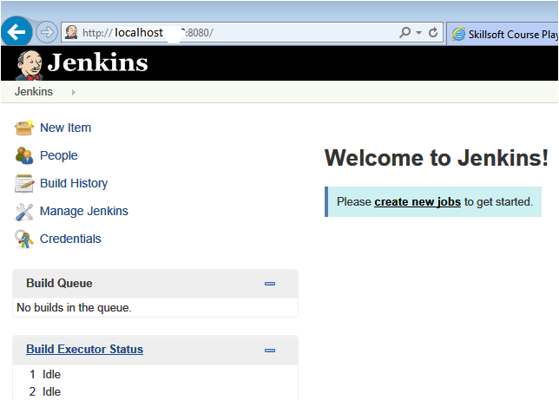
Development
Operations
Jenkins Installation
Once Jenkins is up and running, one can access Jenkins from the link − http://localhost:8080 or http://<hostname>:8080. This link will bring up the Jenkins dashboard.

Slide 9
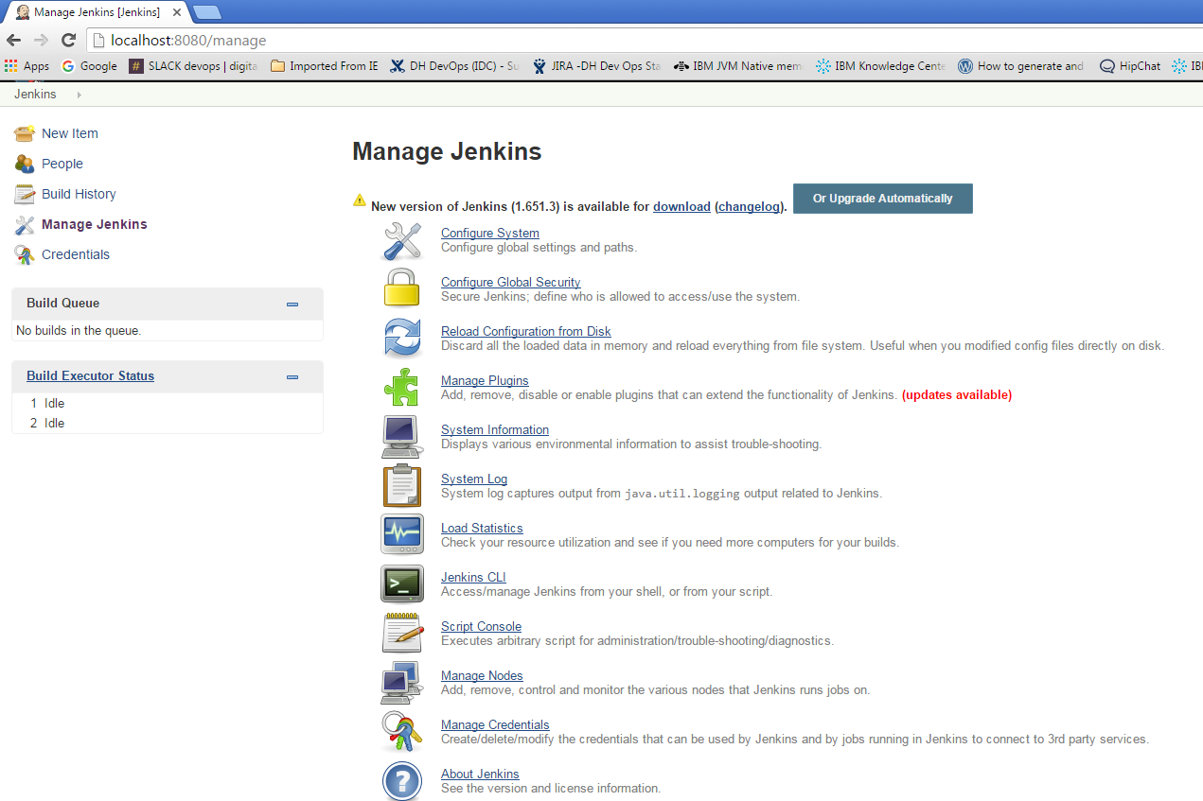
Development
Operations
Configure Jenkins
Go to Jenkins Dashboard -> Manage Jenkins

Slide 10
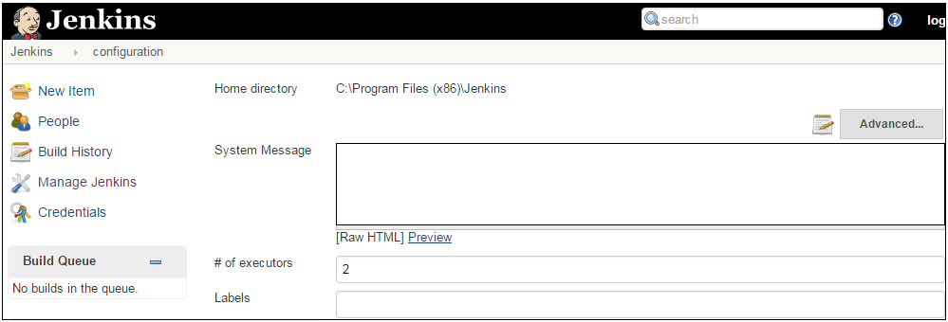
Development
Operations
Configure Jenkins
Jenkins needs some disk space to perform builds and keep archives. One can check this location from the configuration screen of Jenkins. By default, this is set to ~/.jenkins, and this location will initially be stored within your user profile location. In a proper environment, you need to change this location to an adequate location to store all relevant builds and archives. Set Environmental variable JENKINS_HOME to you’re the location you desire.

Slide 11
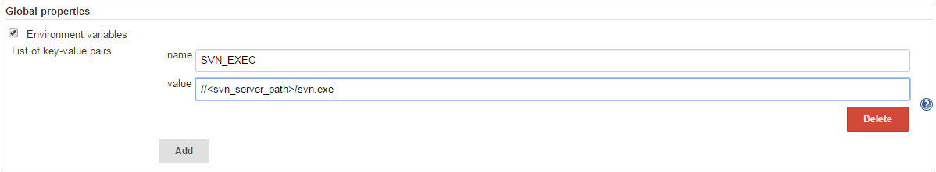
Development
Operations
Configure Jenkins
# of executors :
This refers to the total number of concurrent job executions that can take place on the Jenkins machine. This can be changed based on requirements. Sometimes the recommendation is to keep this number the same as the number of CPU on the machines for better performance.
Environment Variables :
This is used to add custom environment variables which will apply to all the jobs. These are key-value pairs and can be accessed and used in Builds wherever required.

Slide 12
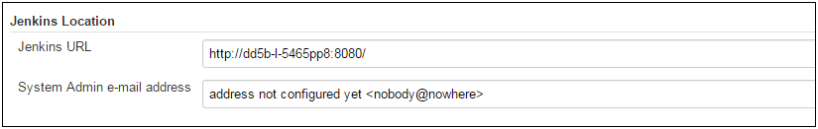
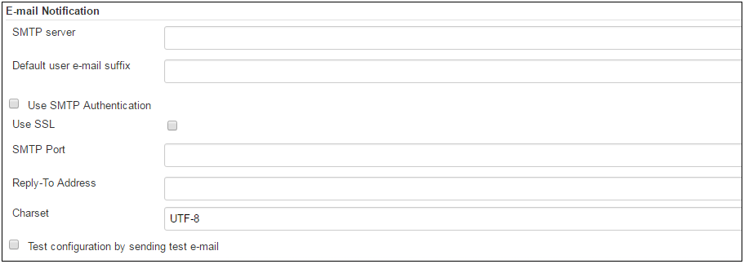
Development
Operations
Configure Jenkins
Jenkins URL :
By default, the Jenkins URL points to localhost. If you have a domain name setup for your machine, set this to the domain name else overwrite localhost with IP of machine. This will help in setting up slaves and while sending out links using the email as you can directly access the Jenkins URL using the environment variable JENKINS_URL which can be accessed as ${JENKINS_URL}.
Email Notification :
In the email Notification area, you can configure the SMTP settings for sending out emails. This is required for Jenkins to connect to the SMTP mail server and send out emails to the recipient list.

Slide 13
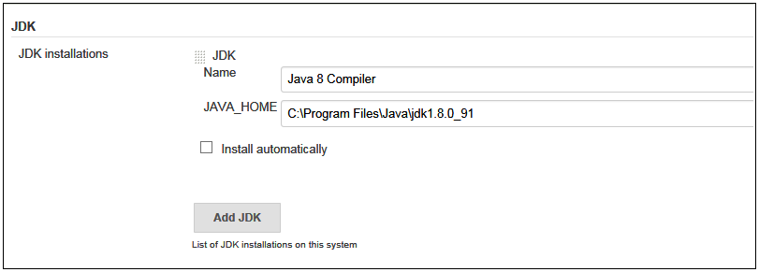
Development
Operations
Configure Jenkins
Let’s say you need to compile a java file using Jenkins. For that you need to have JDK installed on your machine and you need to configure JDK on your Jenkins. Go to Jenkins Dashboard -> Manage Jenkins -> Configure System -> JDK -> JDK Installations
Provide the JDK path. Once can also download JDK via Jenkins if not installed already.
http://localhost:8080/configure. Similarly set the other configurations in Jenkins as required.

Slide 14
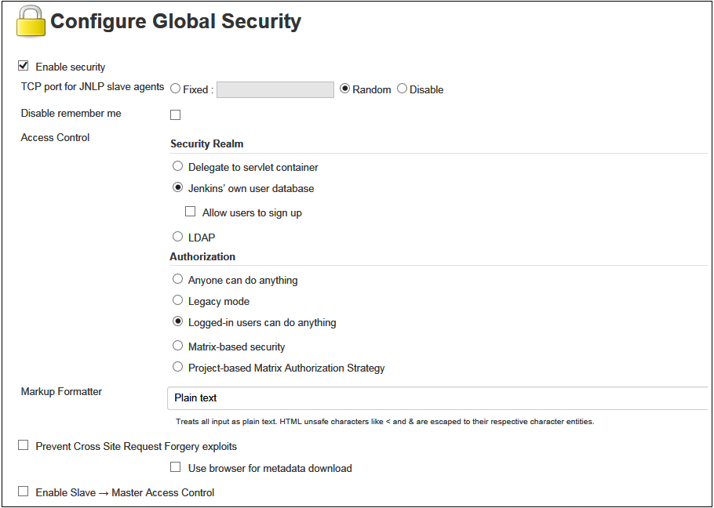
Development
Operations
Configure Jenkins
Go to Manage Jenkins -> Configure Global Security to define the security options.

Slide 15
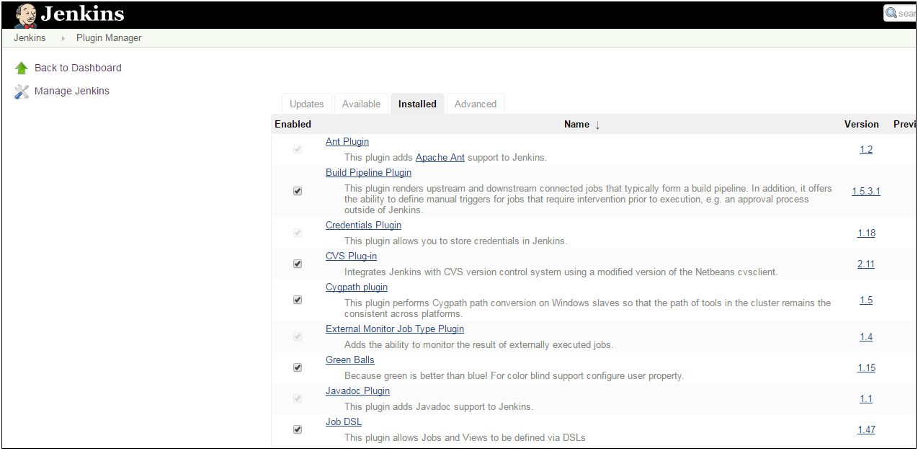
Development
Operations
Configure Jenkins
Go to Manage Jenkins -> Manage Plugins, to install various other plugins

Slide 16
Development
Operations
Configure Jenkins
Some of the commonly used Plugins are :
Build Pipeline Plugin : This plugin renders upstream and downstream connected jobs that typically form a build pipeline. In addition, it offers the ability to define manual triggers for jobs that require intervention prior to execution, e.g. an approval process outside of Jenkins.
Email Extension Template Plugin : This plugin allows administrators to create global templates for the Extended Email Publisher.
Parameterized Trigger plugin : This plugin lets you trigger new builds when your build has completed, with various ways of specifying parameters for the new build.
GitHub plugin : This plugin integrates Jenkins with Github projects.
HipChat Plugin : A Build status publisher that notifies channels on a HipChat server
Slack Notification Plugin : This plugin allows to post build notifications to a Slack channel.
Extended Choice Parameter Plug-In : Adds extended functionality to Choice parameter.
Multiple SCMs plugin : Allows a job to check out sources from multiple SCM providers.

Slide 17
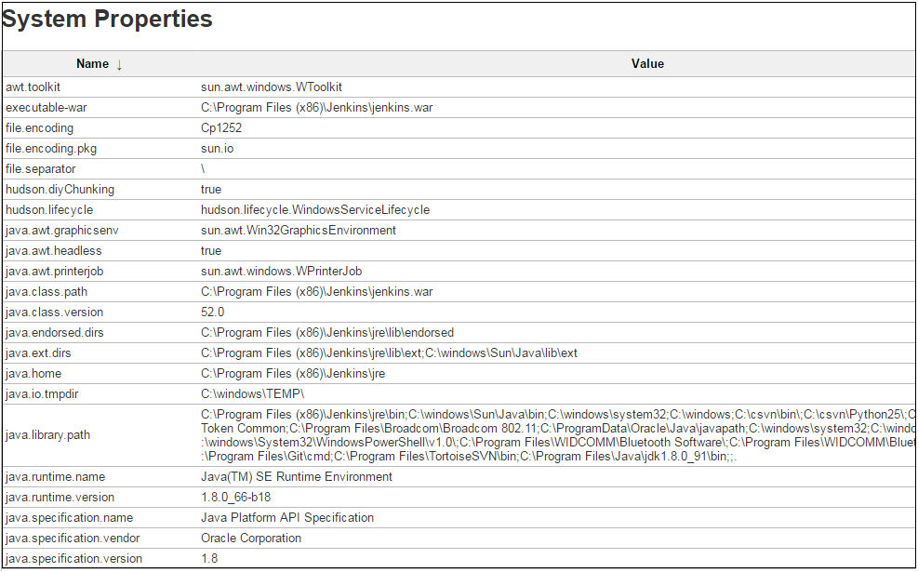
Development
Operations
Configure Jenkins
Go to Manage Jenkins -> Manage Plugins -> System Information. This screen displays a list of all the current Java system properties and system environment variables. Here one can check exactly what version of Java Jenkins is running in, what user it is running under, and so forth.

Slide 18
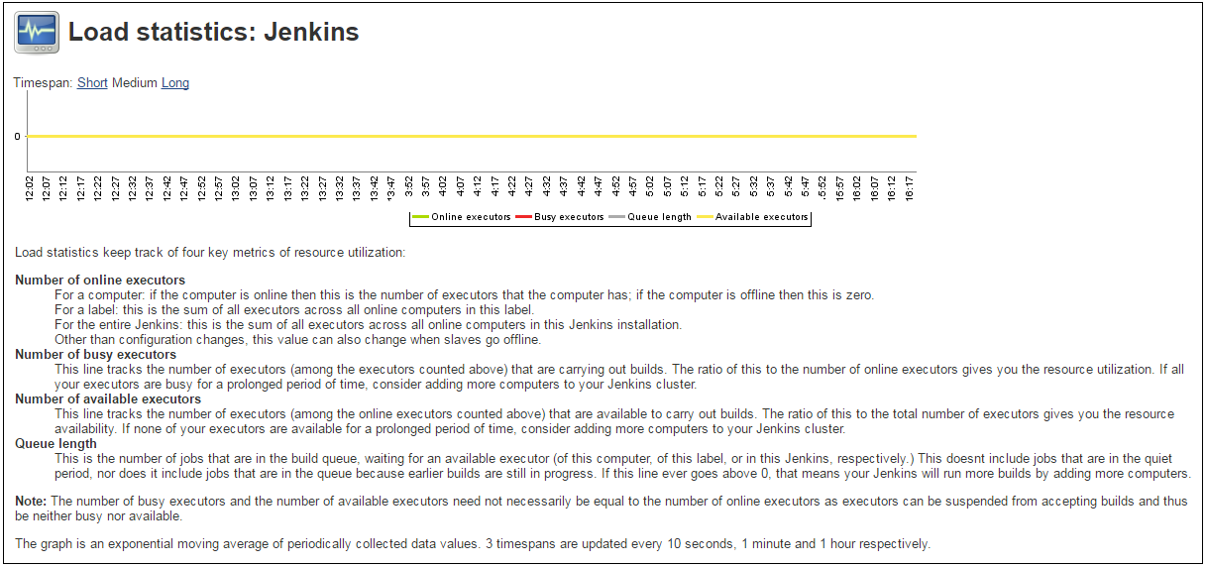
Development
Operations
Configure Jenkins
Go to Manage Jenkins -> Load Statistics. This screen displays graphical data on how busy the Jenkins instance is in terms of the number of concurrent builds and the length of the build queue which gives an idea of how long your builds need to wait before being executed. These statistics can give a good idea of whether extra capacity or extra build nodes is required from an infrastructure perspective.

Slide 19
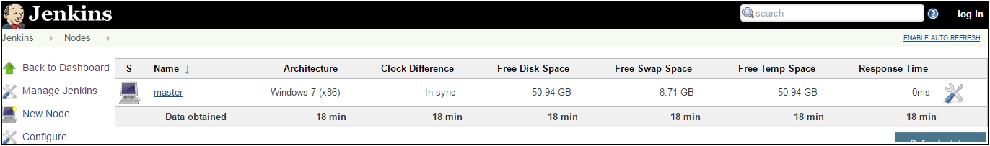
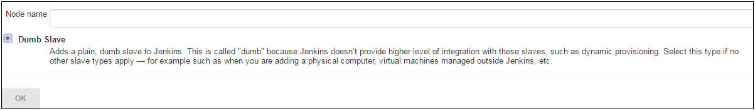
Development
Operations
Configure Jenkins
Go to Manage Jenkins -> Manage Nodes -> New Node, to configure slaves with your master Jenkins. Enter the details of the node slave machine. In the below example, we are considering the slave machine to be a windows machine, hence the option of “Let Jenkins control this Windows slave as a Windows service” was chosen as the launch method. We also need to add the necessary details of the slave node such as the node name and the login credentials for the node machine.

Slide 20
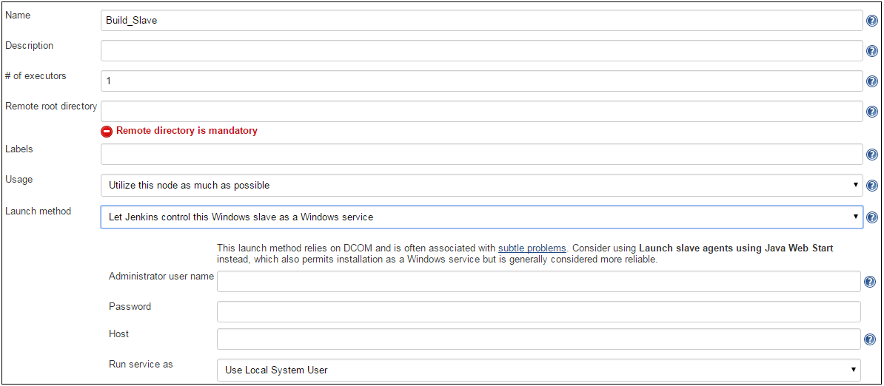
Development
Operations
Configure Jenkins
Setting up a new node as a Jenkins Slave.

Slide 21
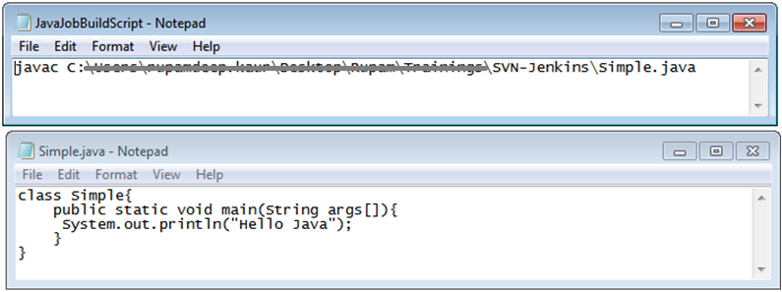
Development
Operations
Building Job with Jenkins
Consider we have a java file to compile using a batch script. Let’s see how we can do this using a Jenkins Job.

Slide 22
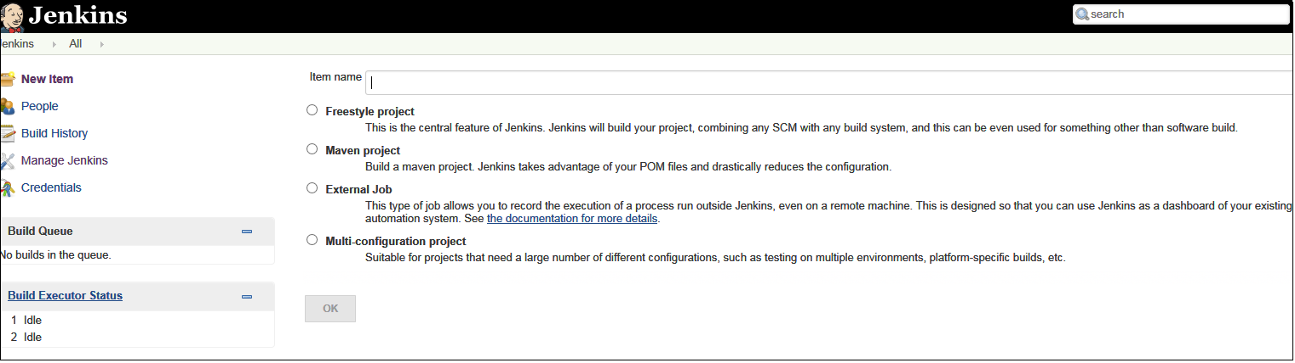
Development
Operations
Building Job with Jenkins
On Jenkins Dashboard, click on New Item and select the required project.

Slide 23
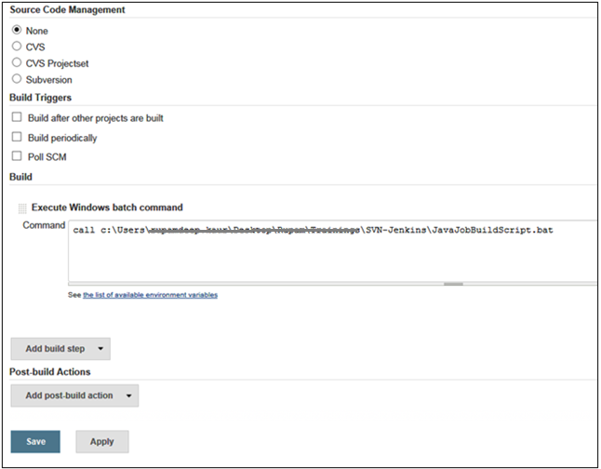
Development
Operations
Building Job with Jenkins
Setup the configuration to execute the jobs in Jenkins.

Slide 24
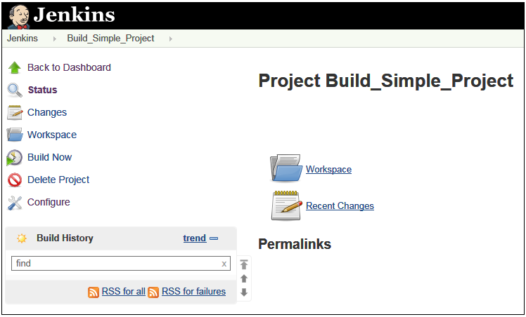
Development
Operations
Building Job with Jenkins
Click on “Build Now” option to run the job which has been created by you.

Slide 25
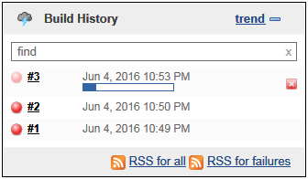
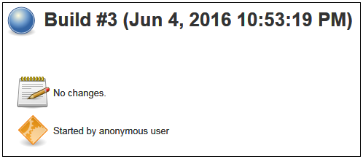
Development
Operations
Building Job with Jenkins
Navigate to the Build History to see the outcome of the jobs. Monitor its details along with its console logs.

Slide 26
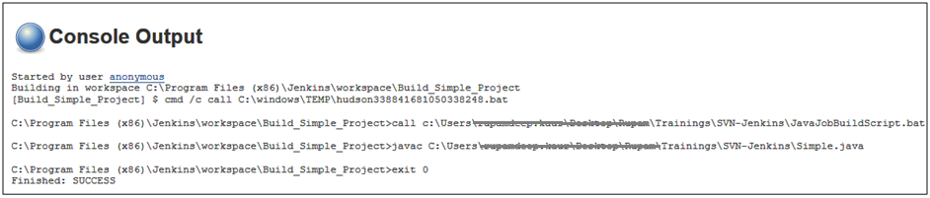
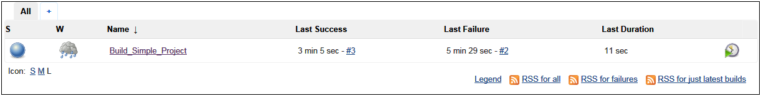
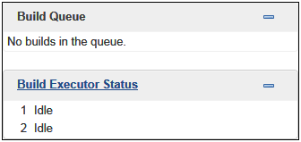
Development
Operations
Monitoring job in Jenkins
Navigate to the Console Output of the job executed to view the logs. You can see the health of the job from the main Jenkins Dashboard Page.

Slide 27
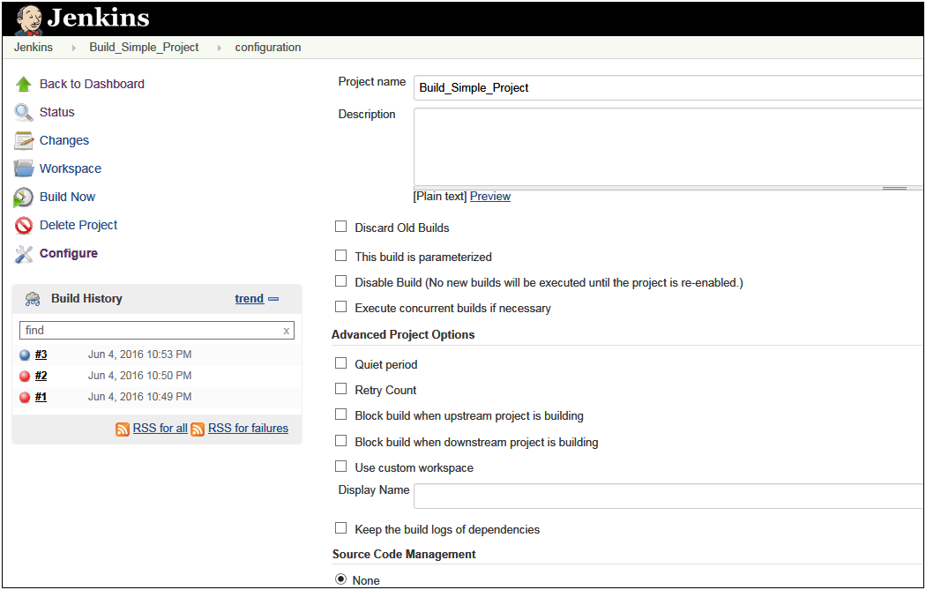
Development
Operations
Job Configuration in detail
Let’s take a look at the Job’ Configuration Page in detail

Slide 28
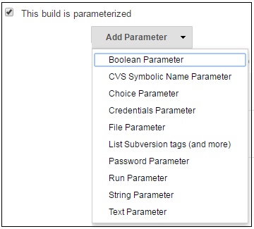
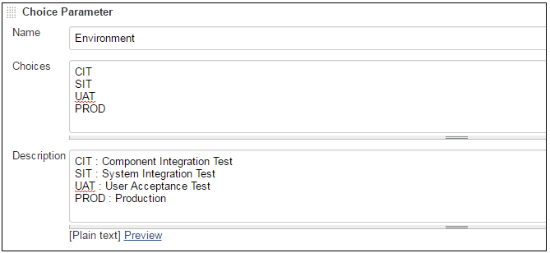
Development
Operations
Job Configuration in detail
You can parameterize your builds just like the way you pass parameters/arguments to your script while executing it. Select “This build is parameterized” option while defining the job’s configuration.

Slide 29
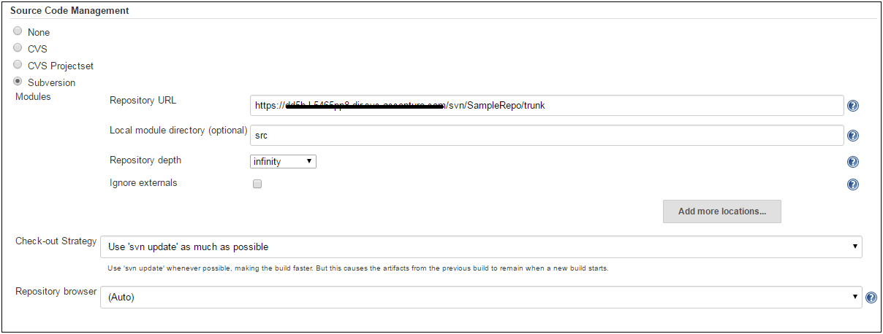
Development
Operations
Accessing job using source control
On the job’s configure page, provide the URL of the version control tool being used.

Slide 30
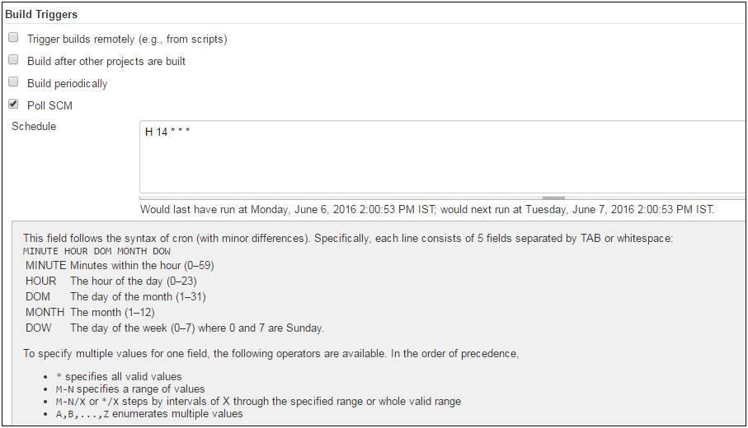
Development
Operations
Schedule Jobs
Use Build Triggers in the job’s configuration to schedule to your jobs.

Slide 31
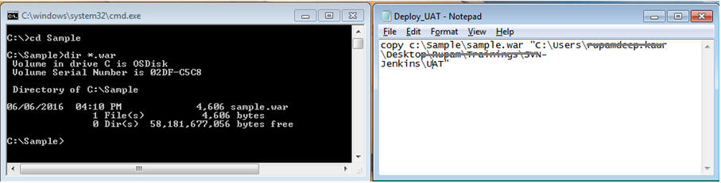
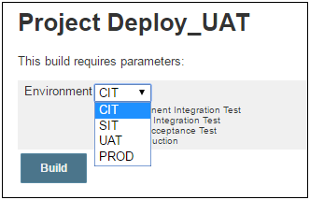
Development
Operations
Setup a Deploy Job
Consider an example whereby a .war file needs to be deployed to UAT environment

Slide 32
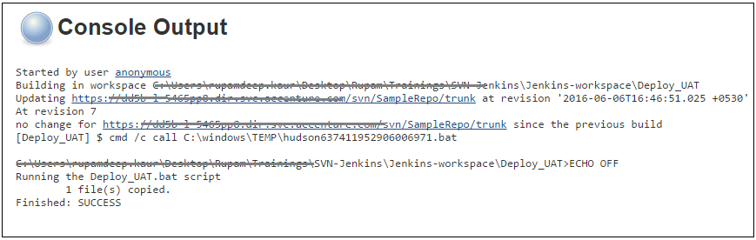
Development
Operations
Setup a Deploy Job

Slide 33
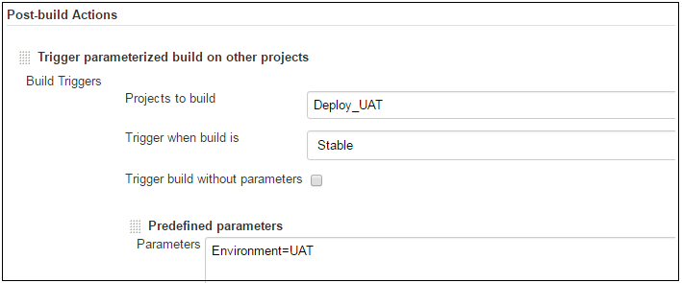
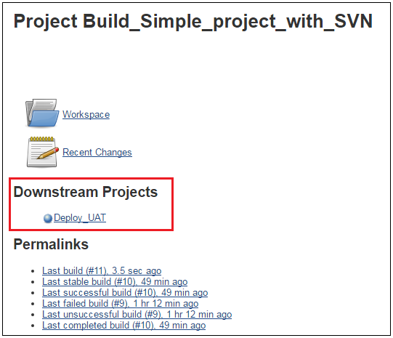
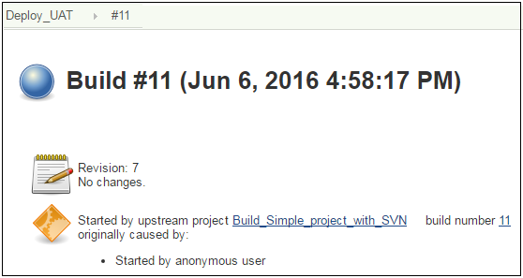
Development
Operations
Connect Upstream-Downstream jobs
If a job is to be scheduled to run after a former job completes successfully, then use the Post-Build Action column in your former job’s configure page to define the job the job which needs to be called out later.

Slide 34
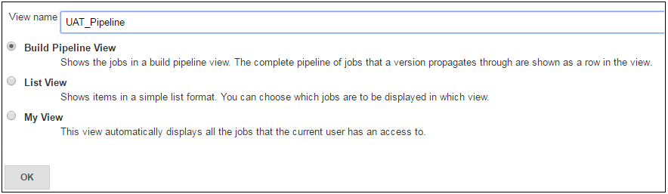
Development
Operations
Jenkins Pipelines
Pipeline plugin provides a Build Pipeline View of upstream and downstream connected jobs that typically form a build pipeline. Pipeline functionality helps Jenkins to support continuous delivery (CD). The Pipeline plugin was built with requirements for a flexible, extensible, and script-based CD workflow capability in mind.

Slide 35
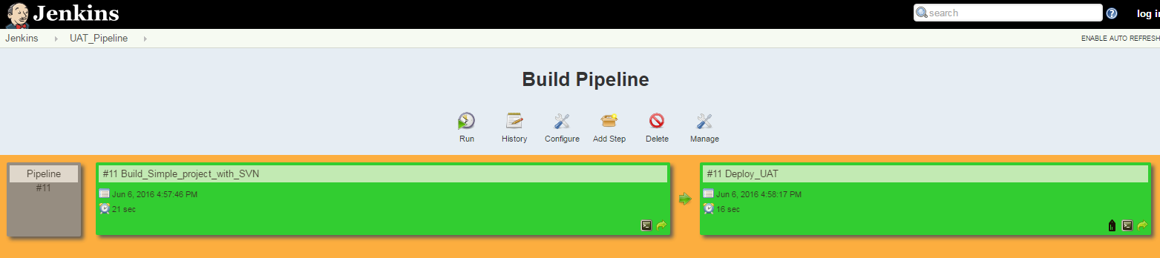
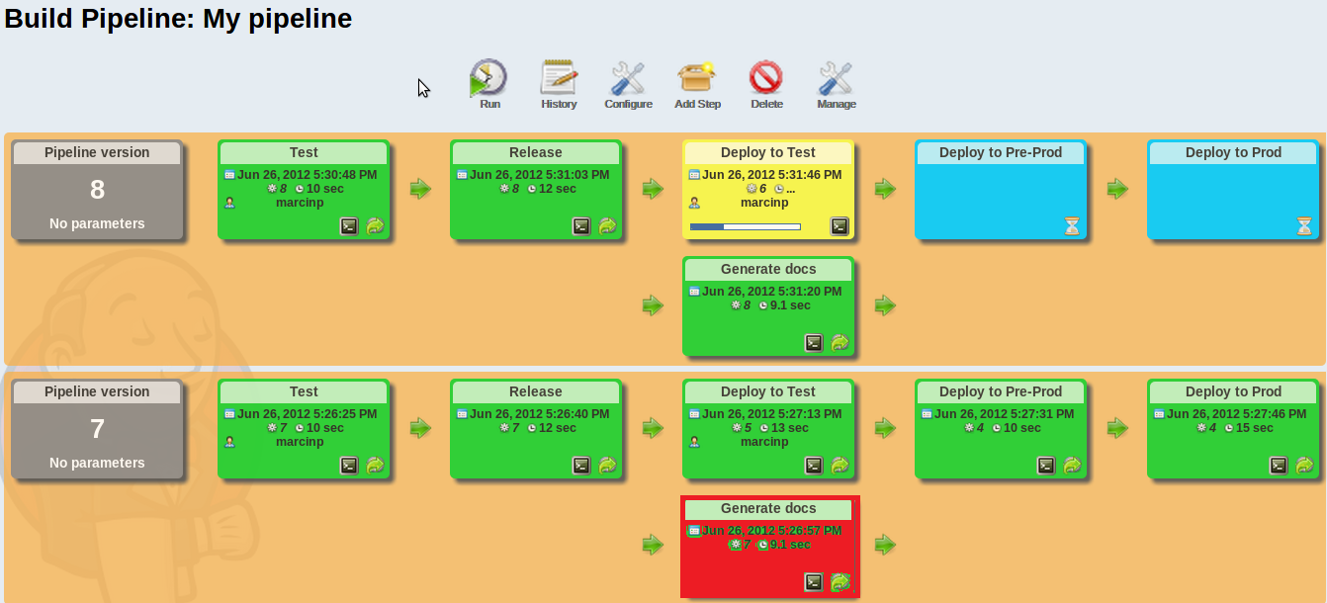
Development
Operations
Jenkins Pipelines
Eg :

Slide 36
Development
Operations
Thank You !

